Slide 2


Slide 3
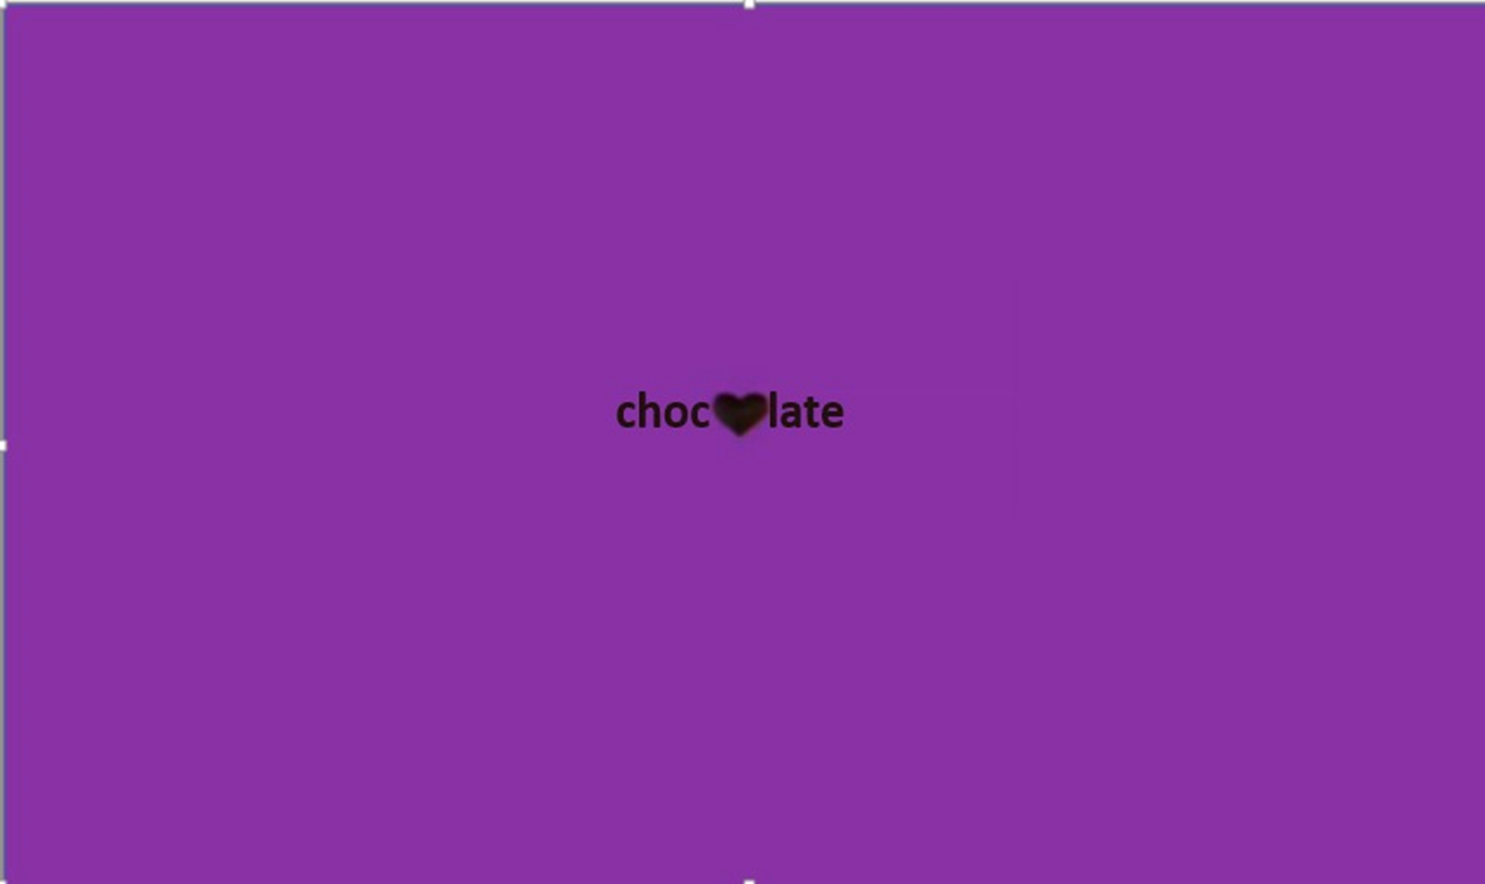

Slide 4
You might have read this title and said you must be joking but we couldn’t be more serious. We spent nights and days arguing about what we’re going to talk about, we went from pirates to dreams to women rights to standards but we finally agreed on, yes you guessed it, “chocolate”. Ww2, AI, space, ocean, medicine, Marie-curie are all very important topics, but let’s be real, we’re a bunch of 17 year olds, and chocolate is the only thing we care about. Chocolate, this delicate sweet thing that everyone likes, you probably asked yourself what can we say about it. Believe it or not, there’s more to chocolate than its tasty flavor.
You might have read this title and said you must be joking, but we couldn’t be more serious. We spent nights and days arguing about what we’re going to talk about. We went from pirates to dreams to women rights to standards but we finally agreed on, yes you guessed it, “chocolate”. Ww2, AI, space, ocean, medicine, Marie-curie are all very important topics, but let’s be real, we’re a bunch of 17 year olds, and chocolate is the only thing we care about. Chocolate, this delicate sweet thing that everyone likes, you probably asked yourself what can we say about it. Believe it or not, there’s more to chocolate than its tasty flavor.

Slide 5
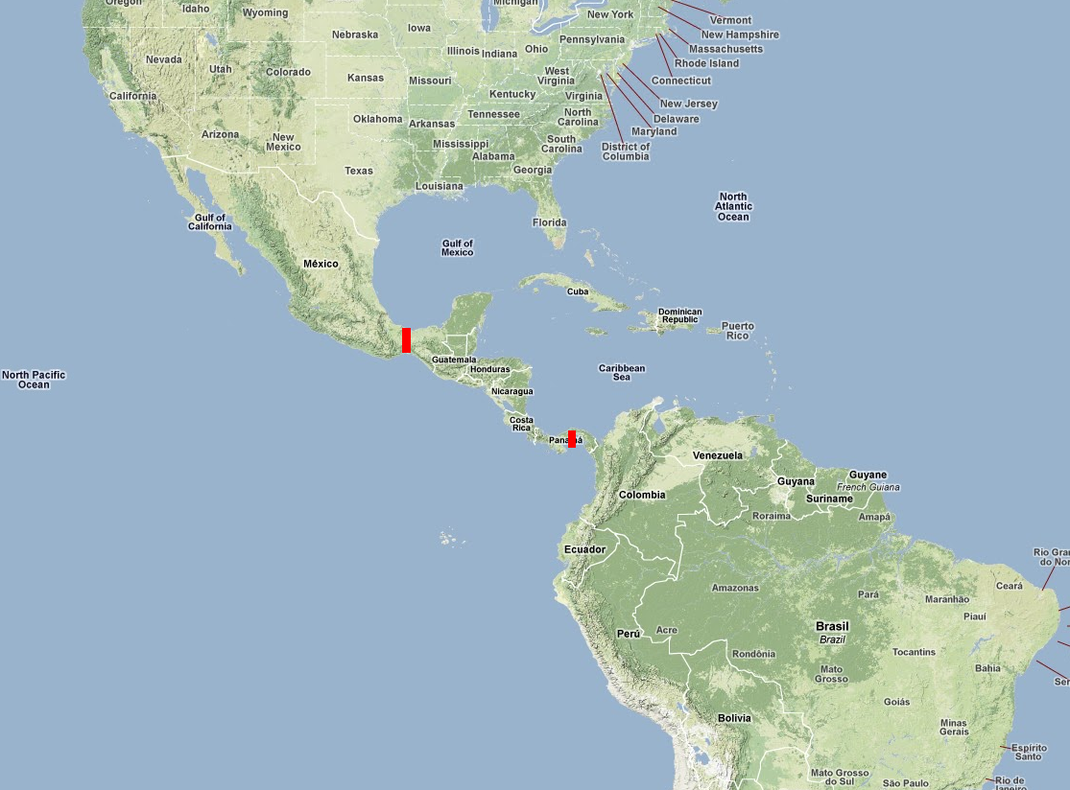

Slide 6
Let’s start at the very beginning, as far back as 1500 BCE, the Olmec discovered the cocoa beans in Mesoamerica. Centuries later the Mayans crushed the cocoa seeds and added chili water and cornmeal to make a thick foamy beverage that they named “xocolatl”, meaning “bitter water” which is like a hot cocoa. The Mayans believed that cocoa was a gift from the god of wisdom so they drank chocolate during rituals, and used it as medicine. They even drank it to prepare for wars, and gave it to soldiers as a reward. Cocoa seeds once had so much value that they were used as a form of currency. Chocolate was literally money growing on trees.

Slide 7
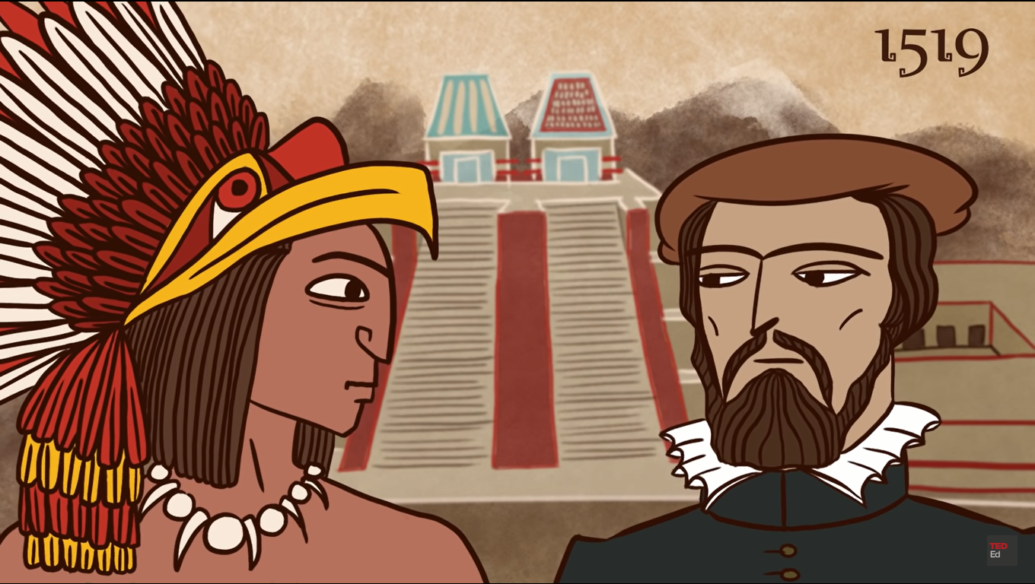

Slide 8
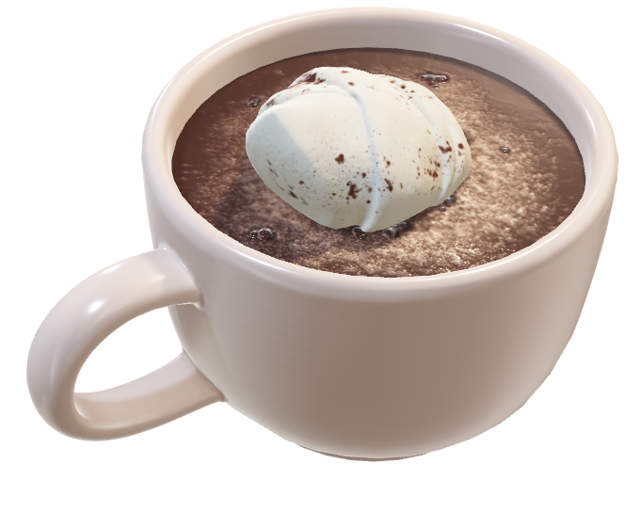
CHOCOLATE IN EUROPE:
In the 16th century, Cortes traveled to America in search of gold and riches, he instead found himself with a cup of cocoa in hand. As recorded by Cortes’s lieutenant, the ruler had 50 jars of the drink brought out and poured into golden cups. Cortes returned home and introduced cocoa seeds to the Spanish and they gave it a reputation as extraordinary.

Slide 9

The Spanish added sugar and honey to make it sweeter and it became popular throughout society, first among the ruling class and then among the common people. Soon no aerostatic home was completed without a dedicated chocolate ware. The Spanish kept it a secret for a long time, in fact it didn’t arrive to France until a century later.
Did you know
Many historical figures. Marie Antoinette, napoleon Bonaparte, Benjamin franklin were chocoholics.
Fun fact

Slide 10
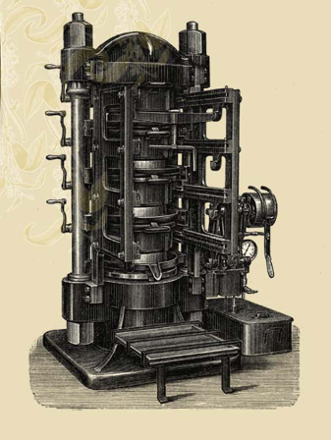

Slide 11
The world of chocolate would change forever in 1828 with the introduction of the cocoa press by coenraad van houten of Amsterdam. This life changing invention could squeeze cocoa butter from roasted cocoa beans, leaving a fine cocoa powder behind. The powder was then mixed with liquid and poured into molds where it solidified into edible bars of chocolate. Not long after, the Swiss chocolatier Daniel peter added powder milk to the mix, thus creating milk chocolate. Around this time chocolate wasn’t a luxury anymore and it became affordable to the public.

Slide 12

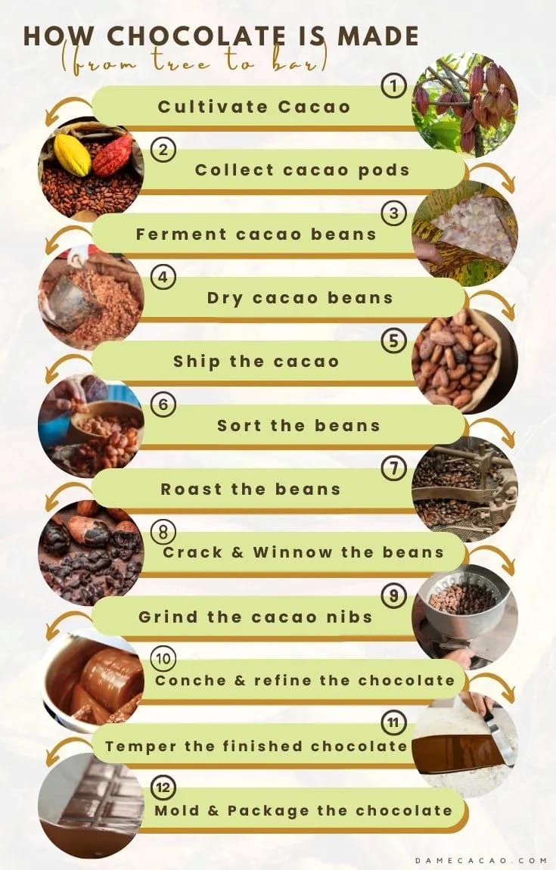
The cocoa production:
Chocolate, which we take for granted, does not come easy

Slide 17
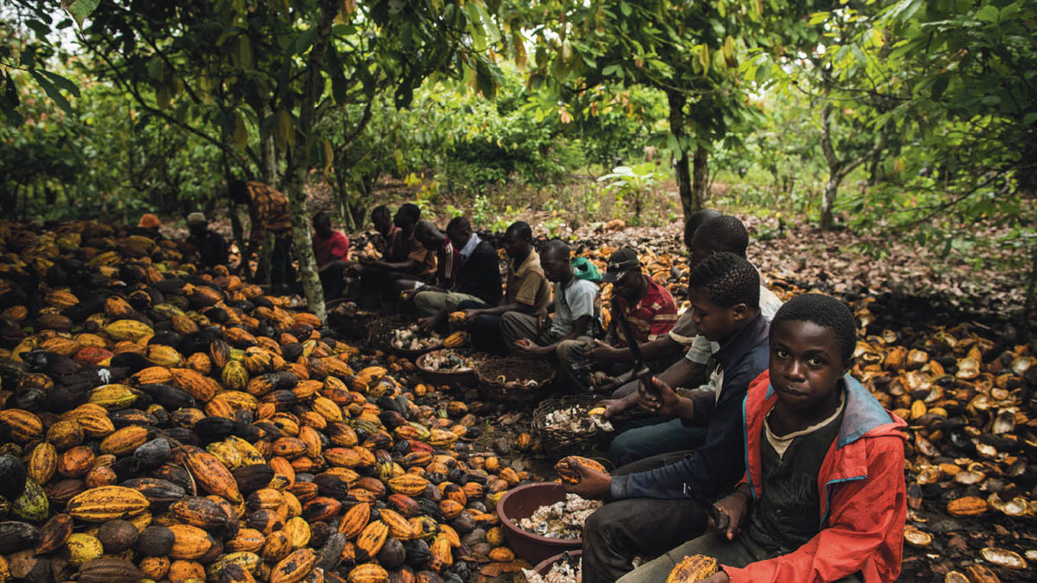
But remember not everything in chocolate is sweet. Throughout history there have been horrific abuse of human rights. Many of the cocoa plantations in West Africa, which supply western companies, used slaves and child labor with the estimation of more 2 million children affected.

Slide 18
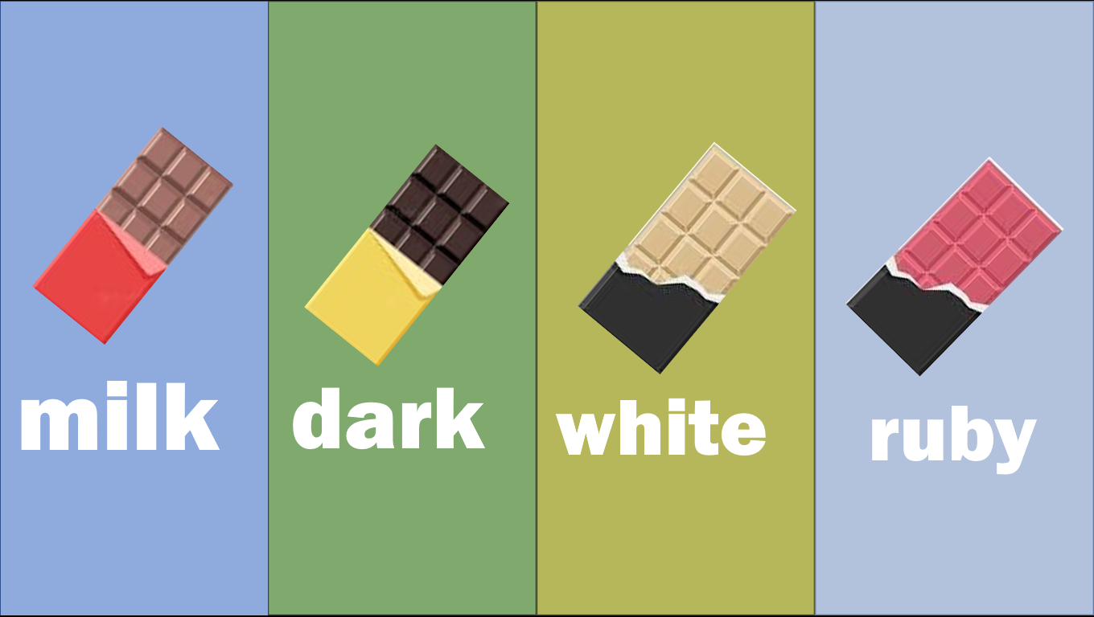
Types of chocolate

Slide 19
Types of chocolate

Slide 20







milk
dark
white
ruby

Slide 21

ruby
milk
dark
white
Ruby chocolate is a relatively new type of chocolate that was introduced in 2017. It has a pinkish-red color and a fruity flavor, and it's made with a specific type of cocoa bean.

Slide 22
white
milk
dark
White chocolate is made with cocoa butter, sugar, and milk solids. It doesn't contain cocoa solids, so it's technically not a true chocolate. It has a sweet and creamy flavor and is often used in desserts.
ruby

Slide 23
dark
milk
Dark chocolate contains a higher percentage of cocoa solids and less sugar than milk chocolate. It has a more intense and slightly bitter taste, and it's often used in baking.
white
ruby

Slide 24
milk
ruby
dark
white
This is the most common type of chocolate, and it's made with milk powder or condensed milk. It typically has a sweet and creamy flavor.

Slide 25
Importance of chocolate
Yes that’s right, chocolate is important. we all know that mother knows best and when she tells you that chocolate isn’t good for your health she’s not absolutely wrong, but it doesn’t mean that chocolate doesn’t have a lot of benefits

Slide 26
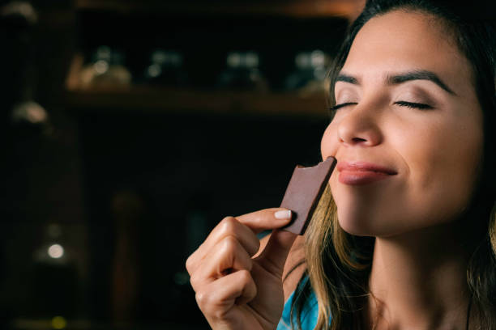
Pleasure: Chocolate is enjoyed by many people because it has a rich and delicious flavor that can evoke feelings of pleasure and happiness. It's often used as a treat or reward for good behavior or achievements.

Slide 27


Health benefits: Chocolate contains antioxidants and flavonoids, which are beneficial for heart health, cognitive function, and reducing inflammation. Dark chocolate, in particular, has been linked to lower blood pressure and improved cholesterol levels.

Slide 28
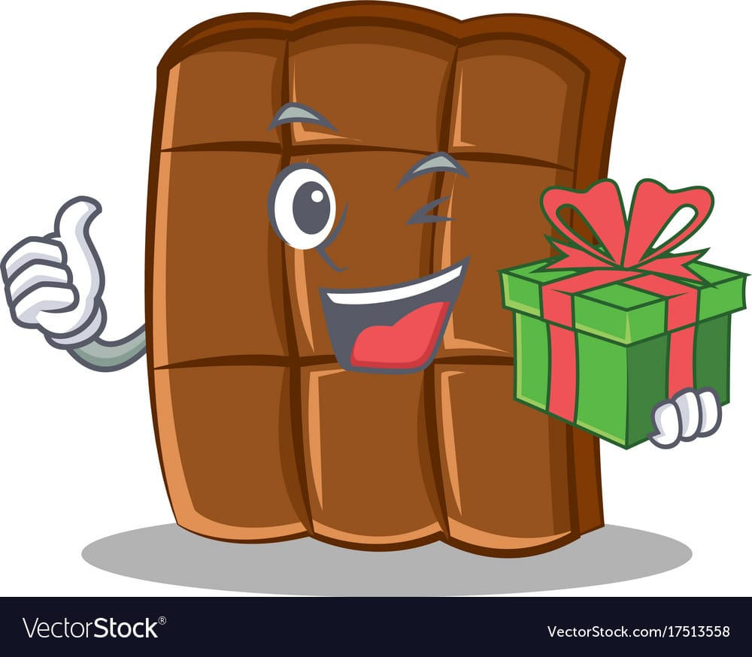
Gift-giving: Chocolate is often given as a gift for special occasions, such as Valentine's Day, Easter, and Christmas. It's a popular choice because it's delicious and can be presented in a variety of forms, such as boxes of chocolates, chocolate bars, and truffles.

Slide 29
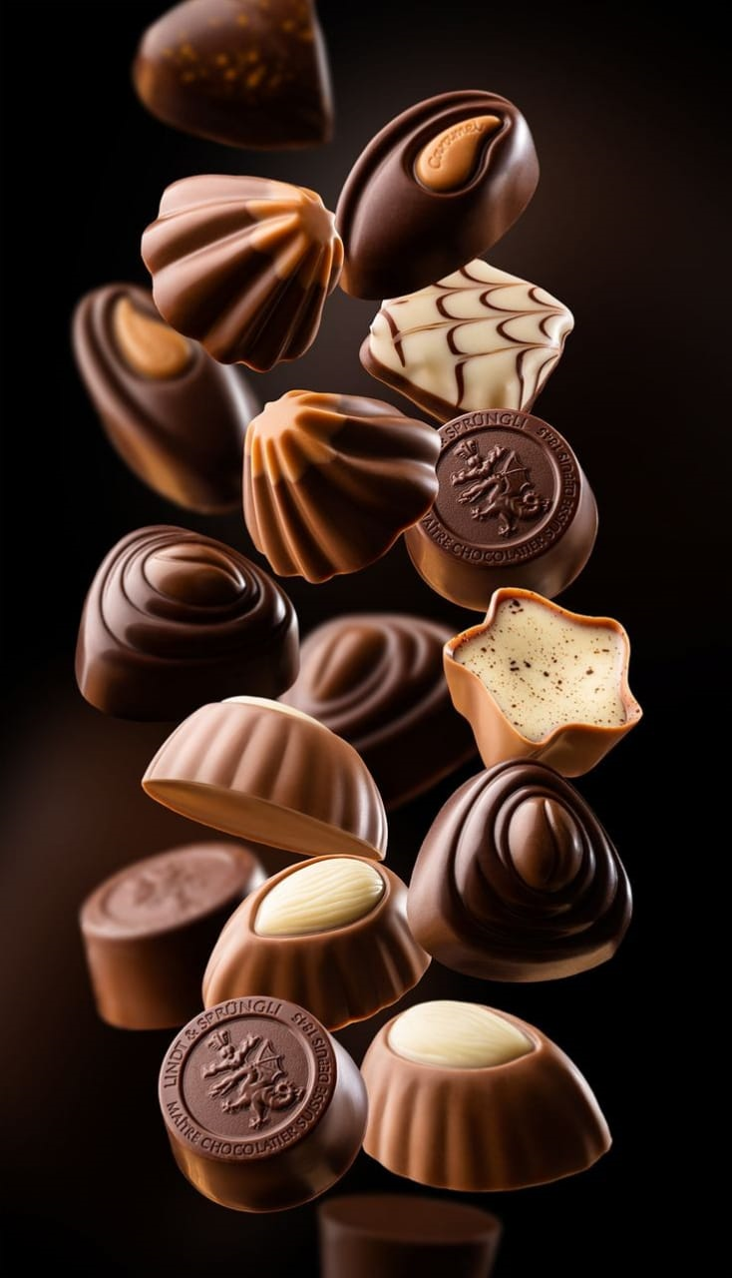
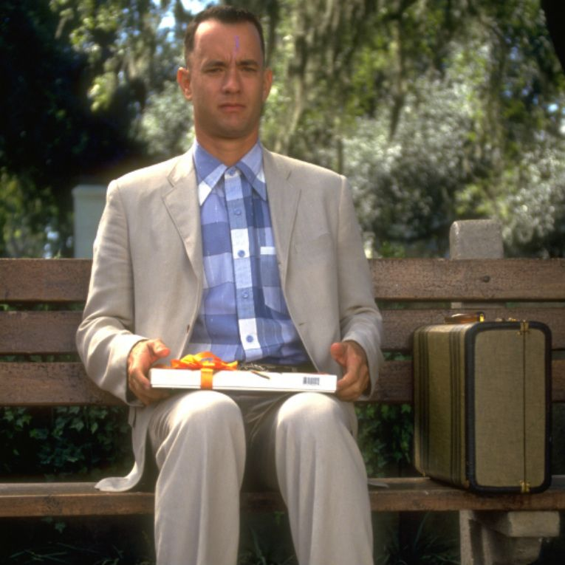
From its cultural significance and economic importance to its health benefits and pleasurable taste, chocolate has something for everyone. Chocolate is a complex and fascinating topic that enters history, culture, and health. By exploring it, we can get a deeper understanding and appreciation for this sweet and delicious treat. With its rich history and continued popularity, it's clear that chocolate will continue to be a beloved treat for generations to come.

Slide 30
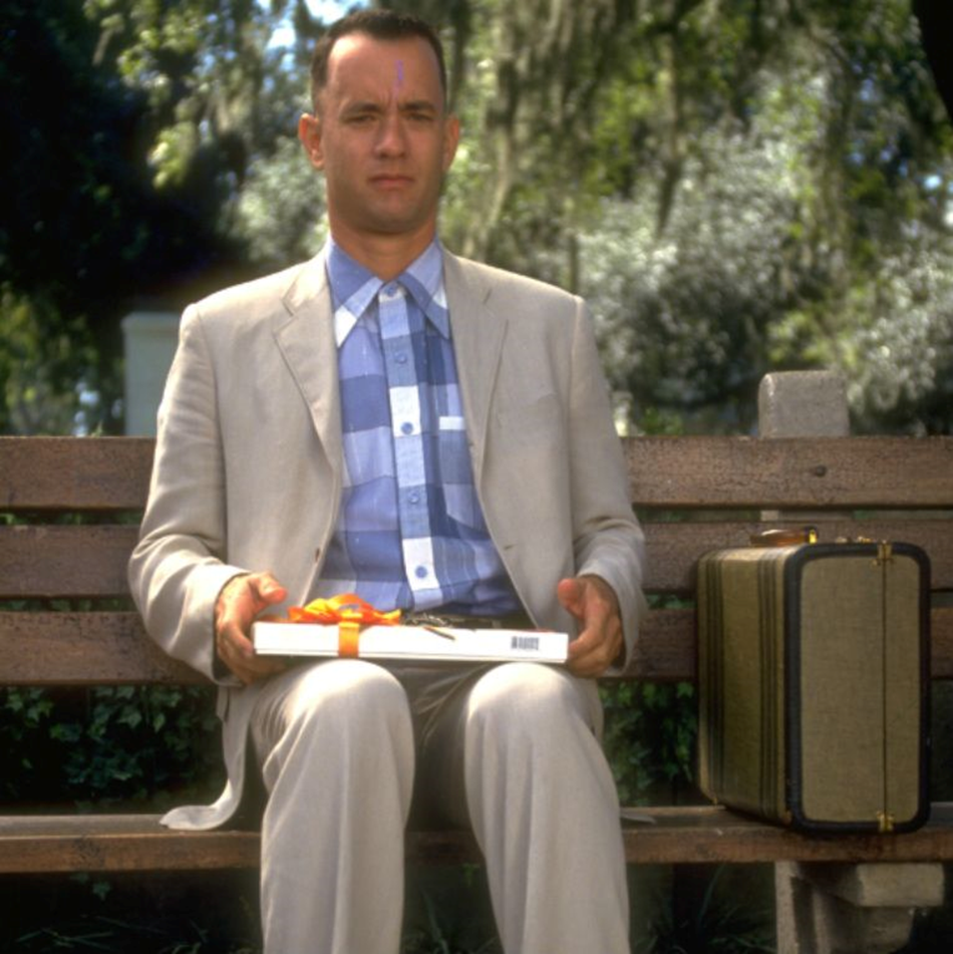
So now, you can show this presentation to your parents so they’ll stop nagging you each time you unwrap a chocolate bar. Don’t forget what Forrest Gump said: “My mama always said: life is like a box of chocolate, you never know what you’re gonna get”.

Slide 31
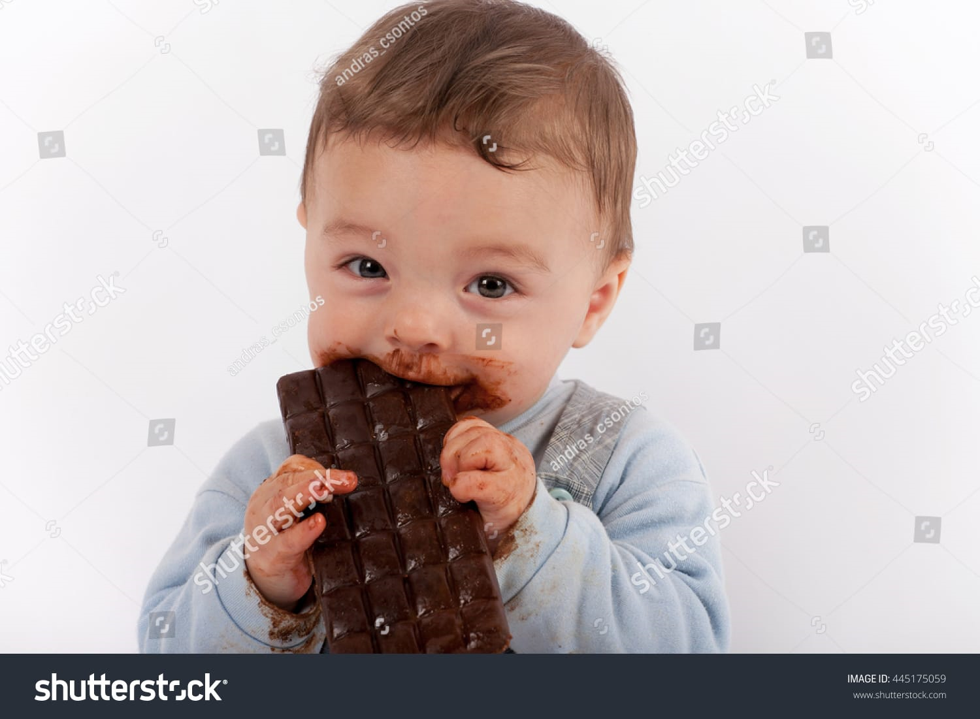
Any questions??

